Slide 1
Microscope
Basics

Slide 2
Objective
Identify the parts of a microscope
calculate magnification and field of view and estimate cell size.

Slide 3
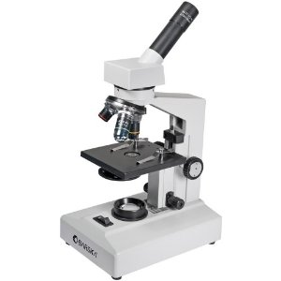
The Light Microscope
Light Microscope - the models found in most schools, use compound lenses to magnify objects. The lenses bend or refract light to make the object beneath them appear closer.
Common magnifications: 40x, 100x, 400x

Slide 4
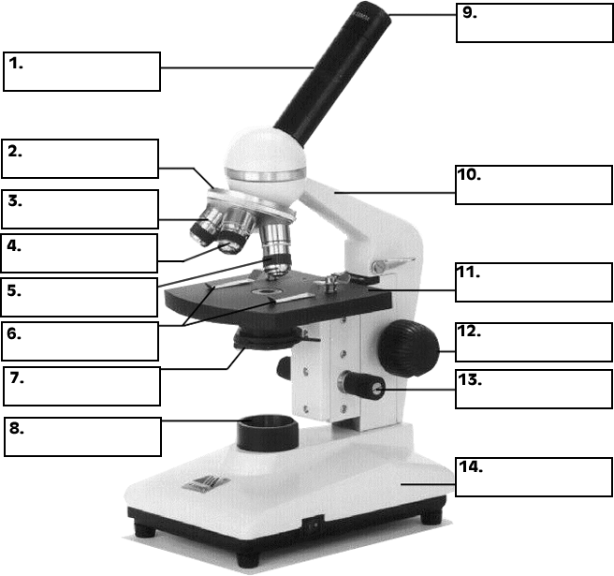
Labeling the Parts

Slide 5
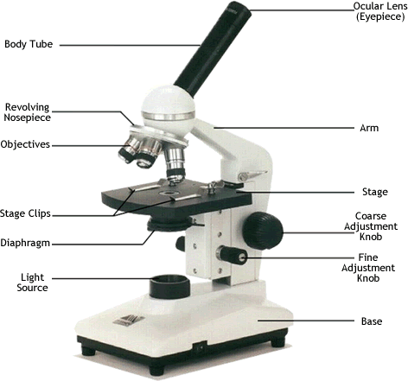
Ocular lens
(Eyepiece)
Body Tube
Nosepiece
Arm
Objectives
Stage
Stage Clips
Coarse Adjustment
Diaphragm
Fine Adjustment
Light
Base
Always carry a microscope with one hand holding the arm and one hand under the base.

Slide 6
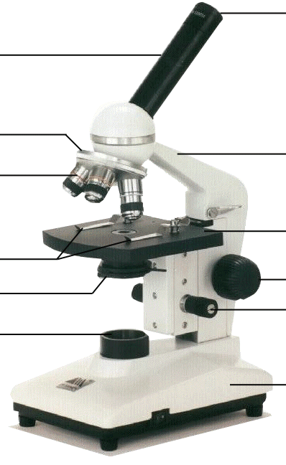
ocular lens
ocular lens
Magnifies; where you look through to see the image of your specimen. They are usually 10X power.

Slide 7
arm
arm
Supports the tube and connects it to the base

Slide 8
stage
The flat platform where you place your slides.
stage

Slide 9
coarse adjustment knob
Moves stage (or body tube) up and down.
coarse adjustment knob

Slide 10
fine adjustment knob
Small, round knob on the side of the microscope used to fine-tune the focus of your specimen after using the coarse adjustment knob.
fine adjustment knob

Slide 11
base
The bottom of the microscope, used for support.
base

Slide 12
body tube
body tube
Connects the eyepiece to the objective lenses.

Slide 13
revolving nosepiece
The part that holds two or more objective lenses and can be rotated to
easily change power.
revolving nosepiece

Slide 14
objective lenses
Adds to the magnification
Usually you will find 3 objective lenses on a microscope. They almost always consist of 4X, 10X, and 40X powers. This is coupled with a 10X ocular lens.
objective lens

Slide 15
objective lenses
The shortest lens is the lowest power, the longest one is the lens with the greatest power.
objective lenses

Slide 16
stage clips
Stage clips hold the slides in place.
stage clips

Slide 17
diaphragm
Controls the amount of light going through the specimen.
Many microscopes have a rotating disk under the stage. This diaphragm has different sized holes and is used to vary the intensity and size of the cone of light.
diaphragm

Slide 18
light
Makes the specimen
easier to see
light

Slide 19
Using the Microscope
The proper way to focus a microscope is to start with the lowest power objective lens first and while looking from the side, crank the lens down as close to the specimen as possible without touching it.
Now, look through the eyepiece lens and focus upward only until the image is sharp.
If you can't get it in focus, repeat the process again.

Slide 20
Using the Microscope
Once the image is sharp with the low power lens, you should be able to simply click in the next power lens and do minor adjustments with the fine focus adjustment knob.
Continue with subsequent objective lenses and fine focus each time.

Slide 21
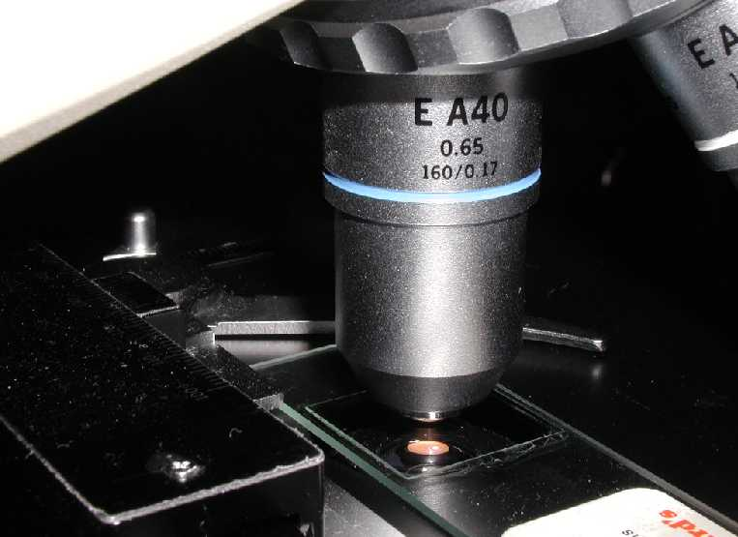
Hints to Using High Power
If your Ocular lens has a black pin show then locate the desired portion of the specimen on the tip of the black pin (if you have no black pin, then position the desired portion of the specimen in the center).
Adjust to the High Power and refocus very carefully using the fine adjustment focus knob.

Slide 22
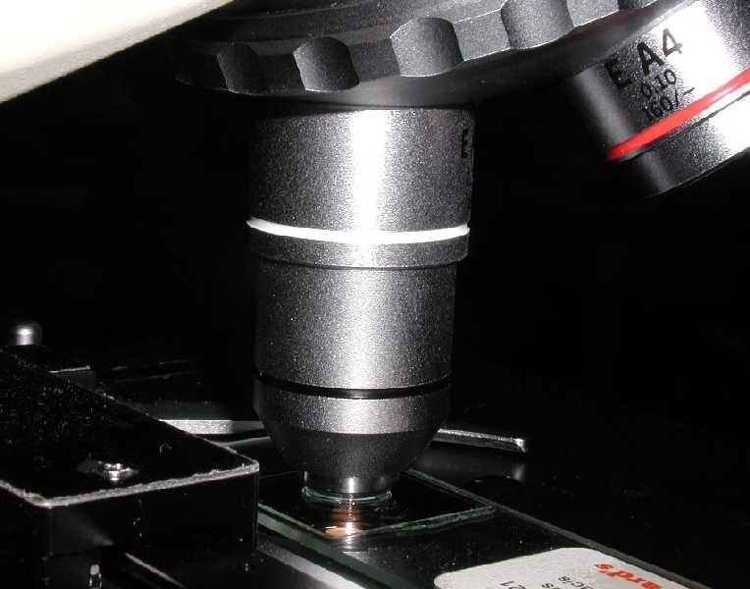
Using High Power
Focus only with fine focus. Hopefully, the specimen will come into focus easily. Do not change focus dramatically.

Slide 23
Magnification & Field
Of view

Slide 24
Objective
Recall and calculate the magnification and field of view of a microscope.

Slide 25
Your microscope has 3 magnifications: Scanning, Low and High. Each objective will have written the magnification.
In addition to this, the ocular lens (eyepiece) has a magnification.
Magnification

Slide 26
Magnification
To calculate the total of magnification, multiply the power of the ocular lens by the power of the objective.
Total magnification =
magnification of eyepiece x magnification of objective lens

Slide 27

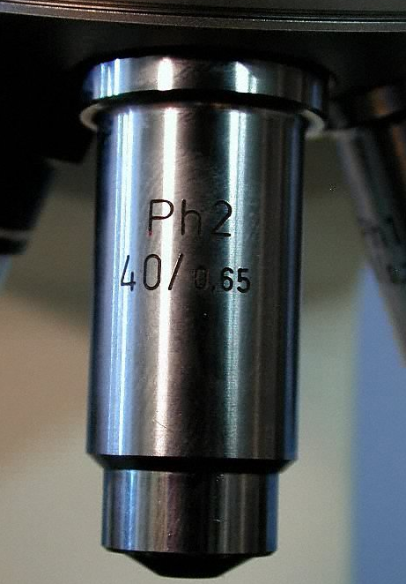
Magnification
What are the powers of magnification for each of
the objectives we have on our microscopes?
Fill in the table in
your workbooks.

Slide 28
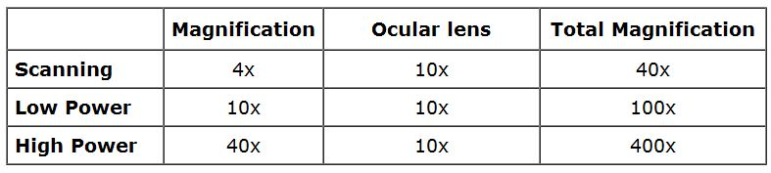
Magnification

Slide 29
Examples
A microscope has an eyepiece lens with a power of 5X. The objective lens being used has a power of 10X. Find the total magnification.
2. A microscope has an eyepiece lens with a power of 15X. The objective lens being used has a power of 40X. Find the total magnification.
3. A microscope has an eyepiece lens with a power of 10X. The objective lens being used has a power of 10X. Find the total magnification.

Slide 30

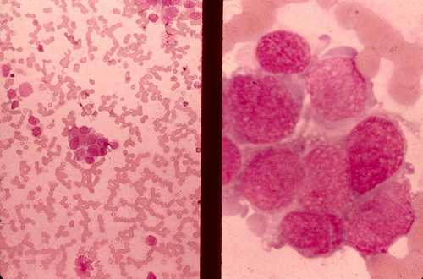
Magnification
We can see better details with higher the powers of magnification, but we cannot see as much of the image.
Which of these images would be viewed at a higher power of magnification?

Slide 31
Changing Units
1mm = 1000 μm (mm x 1000)
E.g.
2 mm =
1000 μm = 1 mm (mm / 1000)
E.g.
100 μm =
2 mm x 1000 = 2000 μm
2 mm x 1000 = 2000 μm
2 mm x 1000 = 2000 μm
10 μm / 1000 = 0.1 mm

Slide 32
Examples-: Convert mm to μm
a) 250 mm
b) 0.1 mm
250 mm x 1000 = 250 000 μm
0.1 mm x 1000 = 100 μm
Examples-: Convert μm to mm
a) 50 μm
b) 20000 μm
50 μm / 1000 = 0.05 mm
20000 μm / 1000 = 20 mm

Slide 33
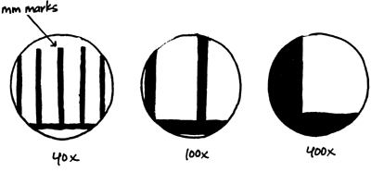
Field of View
Field of View is the actual size of the object/particle being viewed at different magnifications.

Slide 34
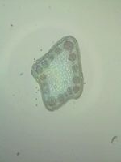
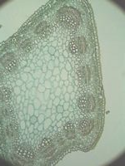
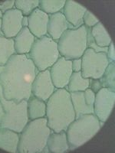
Field of View
alfalfa stem alfalfa stem alfalfa stem @ 40X @ 100X @ 400X
objective lens objective lens objective lens

Slide 35

Field of View

Slide 36
Example: The field of view for a school microscope measures at 1.8mm when using total magnification of 40X.
What is the field of view at 100X total magnification in μm?
STEP 1: Convert 1.8 mm field of view in μm
1.8 x 1000 = 1800 μm
STEP 2: Field of view for 100X magnification
40 = ? .
100 1800
? = 720

Slide 37
Examples
4. Sue observes a clear plastic, millimetre ruler under low power of her microscope. She sees three divisions of the ruler. What would be the field diameter of Sue’s microscope on low power? (in micrometers ('µm')
5. Convert each of the following to micrometers (µm).
a) 3.5mm
b) 4.0mm
c) 1.5 cm
d) 0.5 cm
Low power field of view = 3mm x 1000
= 3000µm
Field of view = 3.5mm x 1000 = 3500µm
Field of view = 4.0mm x 1000 = 4000µm
Field of view = 15mm x 1000 = 15000µm
Field of view = 5.0mm x 1000 = 5000µm

Slide 38
Examples
6. The following information is for a microscope which has an eyepiece lens (ocular lens) with a power of 10X:
Using the information provided above, calculate the field diameter for medium and high power.
Objective Lens | Objective Lens Power | Field Diameter (mm) | Field Diameter (μm)
low | 4X | 3.5
medium | 10X
high | 40X
3500µm
1.4
1400µm
0.35
350µm

Slide 39
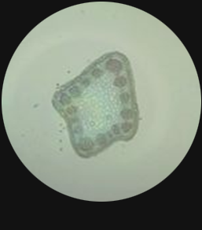
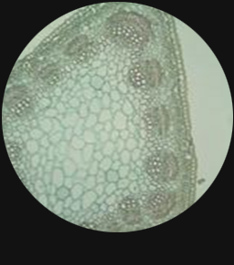
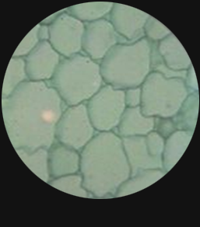
Field of View
1 mm
@ 40X @ 100X @ 400X
What is the size of the alfalfa stem cells found in the red circle, if the ocular magnification is 10X?

Slide 40
Field of View
What is the size of the alfalfa stem cells found in the red circle?
Firstly, find the Total magnification at 40X objective lens magnification and the field of view.
Total Magnification = 40 x 10
= 400X
Field of View (in μm) = 1.5 mm x 1000
= 1500 μm
1 mm

Slide 41
Field of View
What is the size of the alfalfa stem cells found in the red circle?
Secondly, find the Total Magnification of the higher magnification.
Total Magnification = 400 x 10
= 4000X
1 mm

Slide 42
Field of View
What is the size of the alfalfa stem cells found in the red circle?
Thirdly, find the field of view of the higher magnification.
Low Magnification = High Field of View .
High Magnification Low Field of View
400 = ? .
4000 1500
High field of view = 150 μm (0.15 mm)
1 mm

